Slide 1


BY: TEAM-PACE MAKERS Sanskruti Manoria (NUID 002643300)
Yashwanth Behara (NUID 002299461 )
Venkata Deepak Viswanadha (NUID 002299829 ) Nikitha Kambhampati (NUID 002272863)
ECOWELL
Under guidance of Prof. Amuthan Arulraj

Slide 2

What is ECOWELL
EcoWell is a cutting-edge application designed for nutritional analysis of food items, putting the power of information and healthy choices in your hands. Simply input a product's barcode id, and EcoWell seamlessly connects to Open Food APIs, providing detailed nutritional facts and ingredient information.

Slide 3









TECHNOLOGY STACK

Slide 4
EXTERNAL APIs
Product Information and Nutrition:
- [Open Food Facts](https://world.openfoodfacts.org/): A database of food products from around the world, including nutritional information.
User Authentication:
- [Auth0](https://auth0.com/): A widely used identity and authentication platform.
Dietary Preference:
- [Edamam Recipe Search API](https://developer.edamam.com/edamam-recipe-api): Provides detailed nutritional information for a given recipe, including whether it's vegetarian or not.
Product Recommendation:
- [Open Food Facts - Product Recommendation API](https://world.openfoodfacts.org/): A database of food products from around the world, including nutritional information.

Slide 5
KEY FEATURES OFFERED BY ECOWELL
Live application statistics
Product Nutritional Analysis and Recommendations
Personalized Product Recipes
Secure Authentication and Authorization
Routes Protection
CRUD operations
Multilingual support (English, Spanish, French) – Internationalization
PWA
PDF Download Functionality
Profile Analytics
Community Portal
Feedback System
User friendly interface

Slide 6
USE CASES
Barcode ID Nutrition Lookup:
Effortlessly retrieve comprehensive nutritional data and ingredients by scanning a product's barcode.
Related Products and Favorites:
Discover related products based on your entries and mark your favorites for quick and personalized recommendations.
Customised Search on recipies :
Tailor your preferences with filters like vegetarian or no sugar to receive recipe suggestions enriched with essential data such as calories and keywords.
PDF Recipe Downloads:
Conveniently download PDFs of your favorite recipes for easy reference or sharing with friends.
Help Center and User Guide:
Navigate the app seamlessly with a detailed user guide available in the Help Center.
Profile Analytics:
Gain insights into your nutritional habits and preferences through personalized profile analytics based on the data entered during sign-up.

Slide 7
USE CASES
7.Live App Data:
Stay informed with real-time statistics on the app's usage, including the number of registered users and total available recipes.
8.Multilingual Support:
EcoWell supports both English and French languages, ensuring accessibility for a diverse user base.
9.Community Forum and Feedback:
Engage with like-minded users in the community forum, share experiences, and provide valuable feedback to enhance the app's features.
10.Secure Authentication and Authorisation:
Safeguard your data with OAuth authentication, ensuring a secure and reliable login and sign-up process.

Slide 8
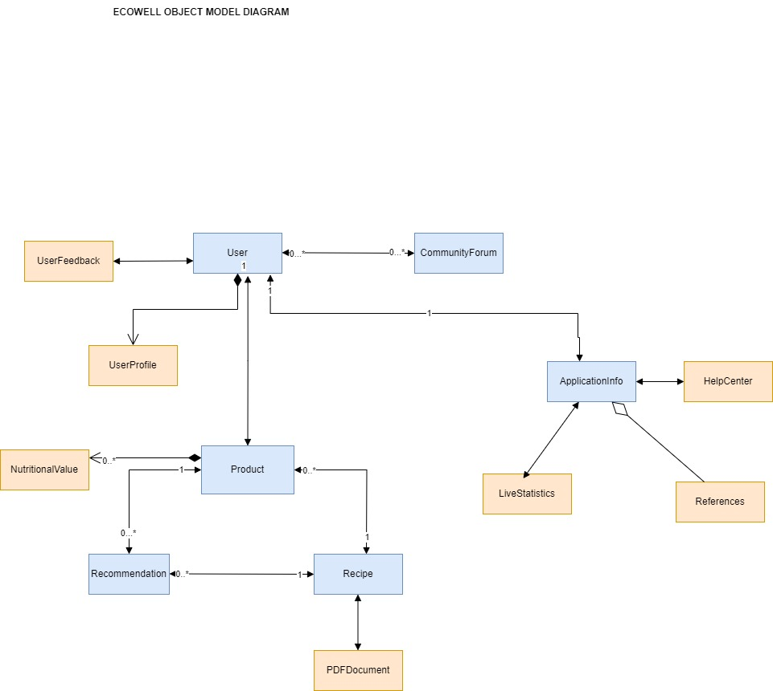
OBJECT-MODEL DIAGRAM

Slide 9
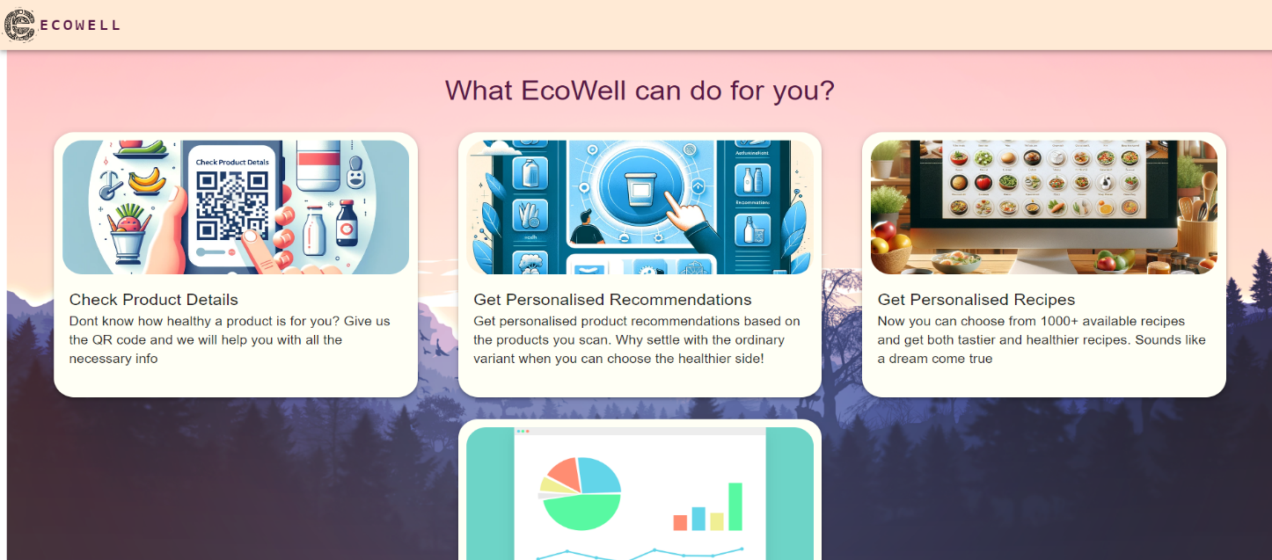
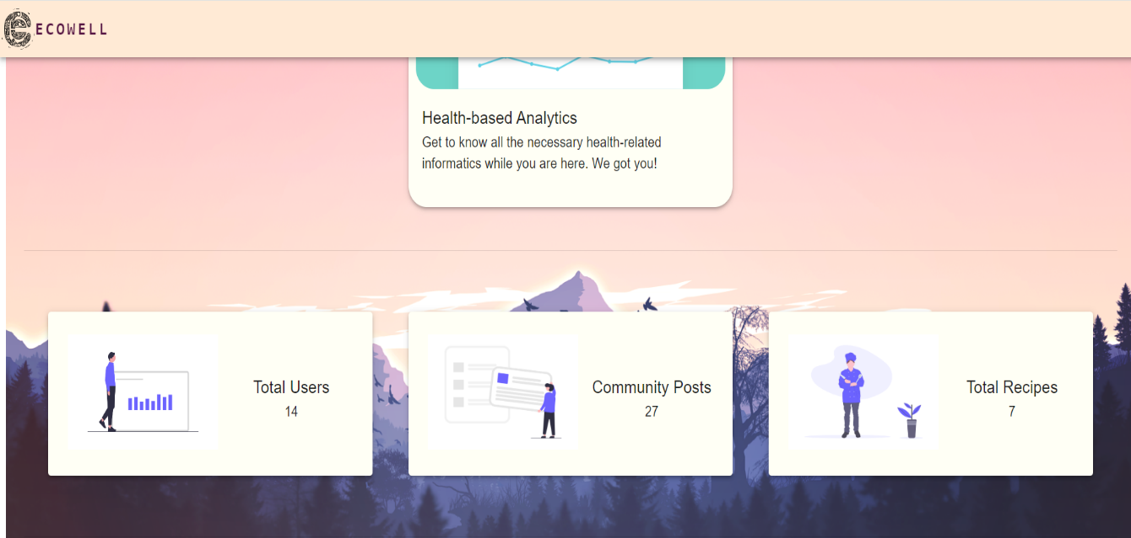

SCREENSHOTS – LANDING PAGE

Slide 10
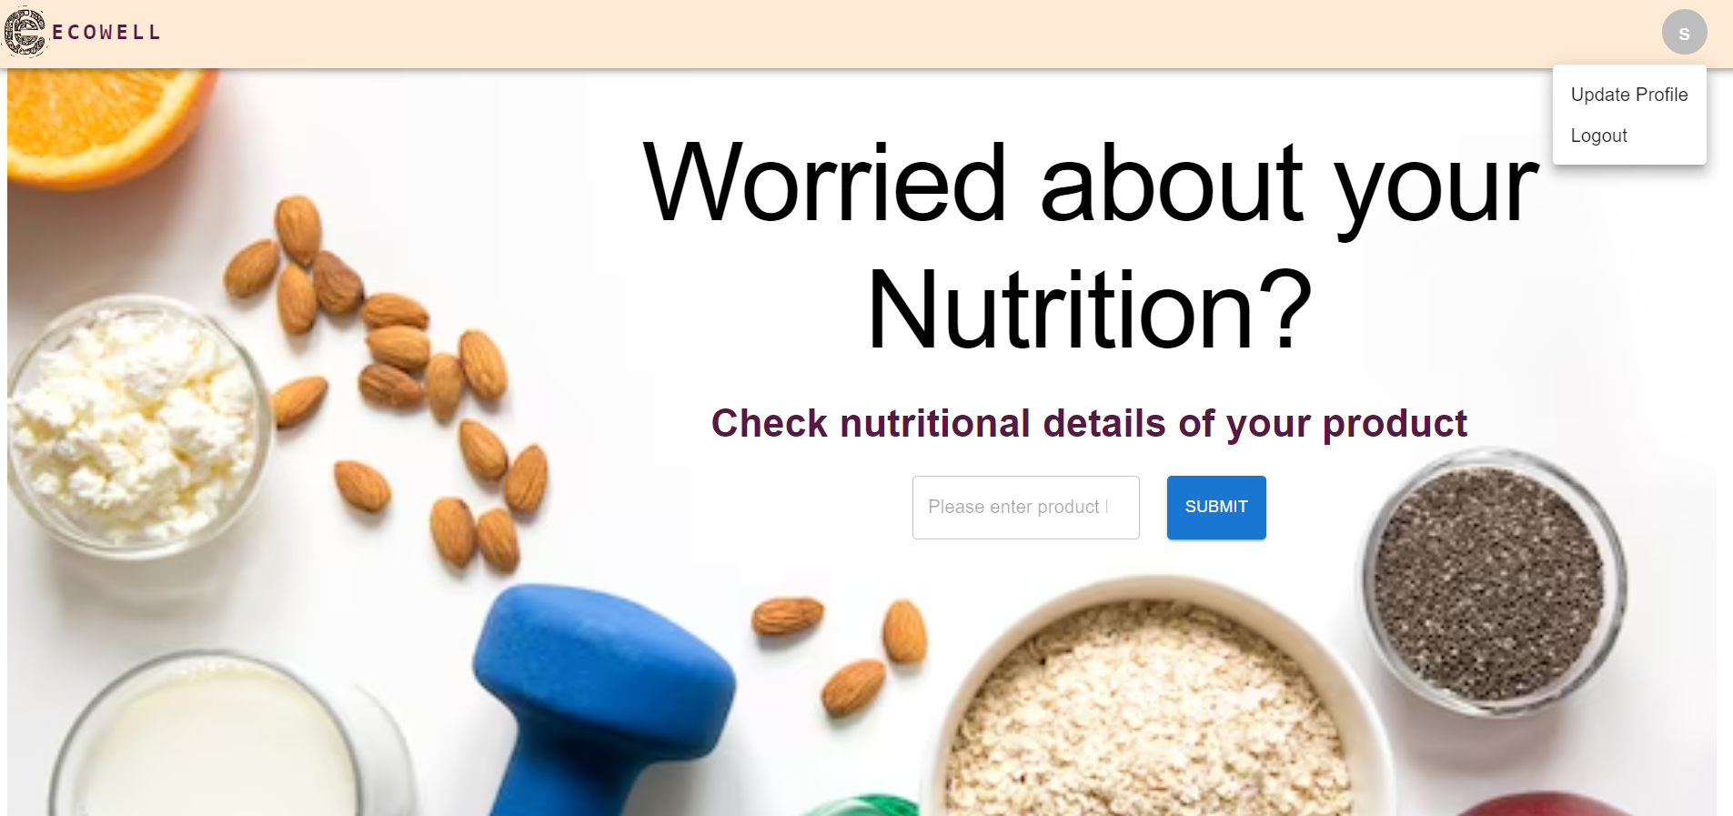
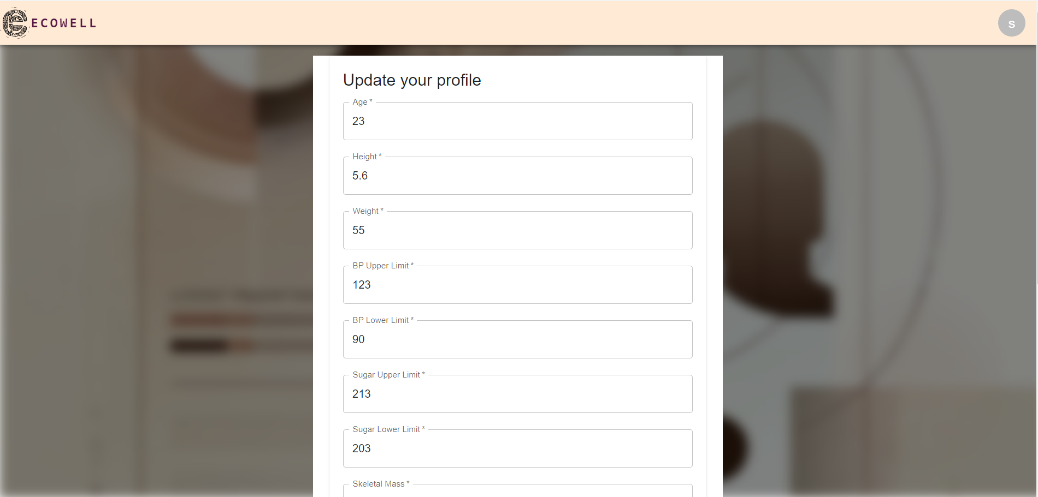
NUTRITIONAL ANALYSIS AND UPDATE PROFILE

Slide 11
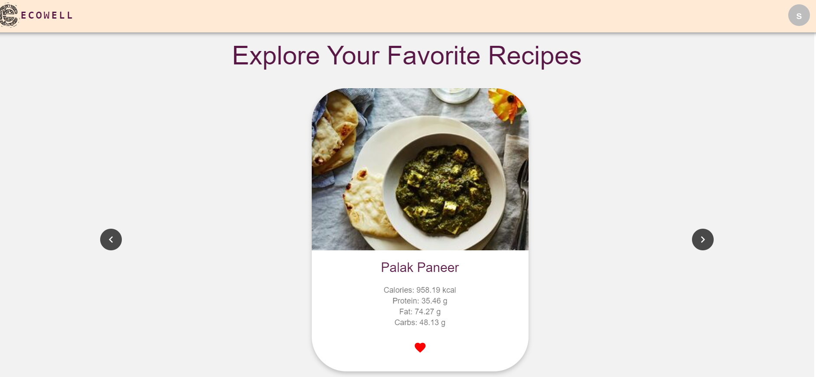
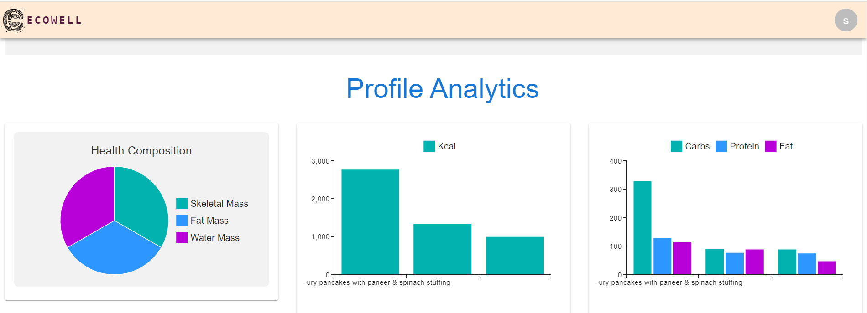
FAVORITE RECIPES AND PROFILE ANALYTICS

Slide 12
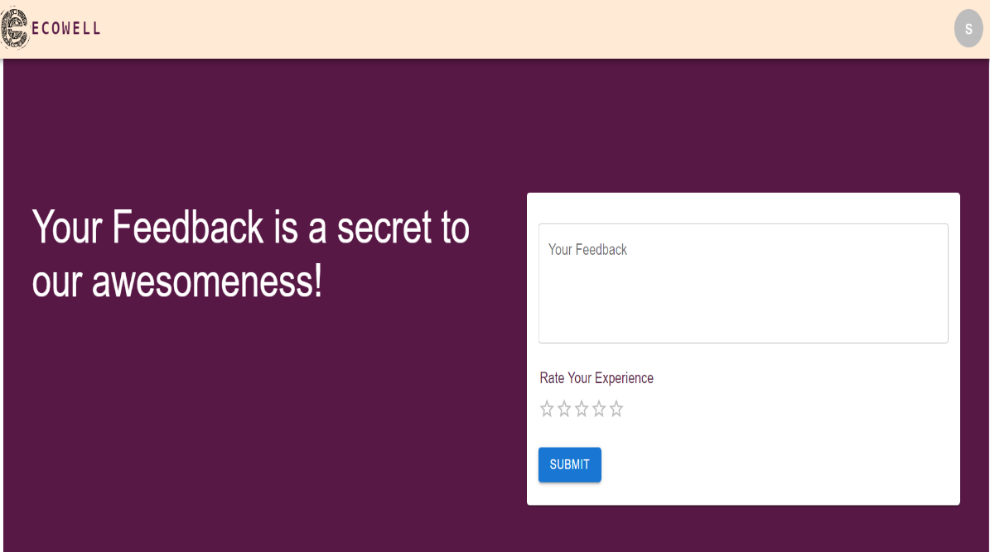
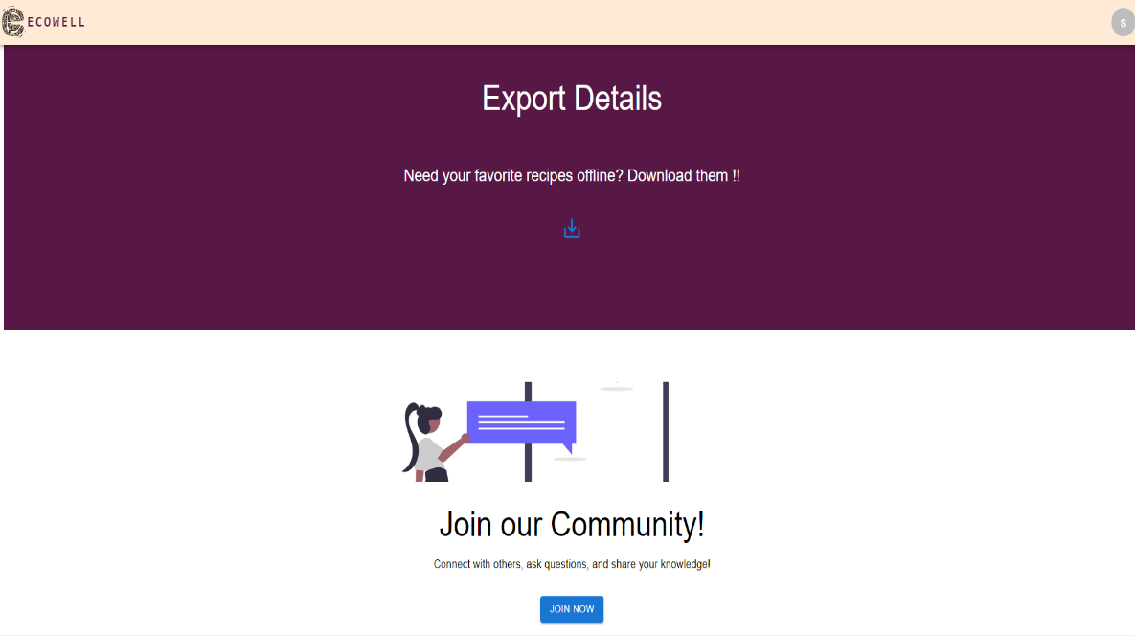
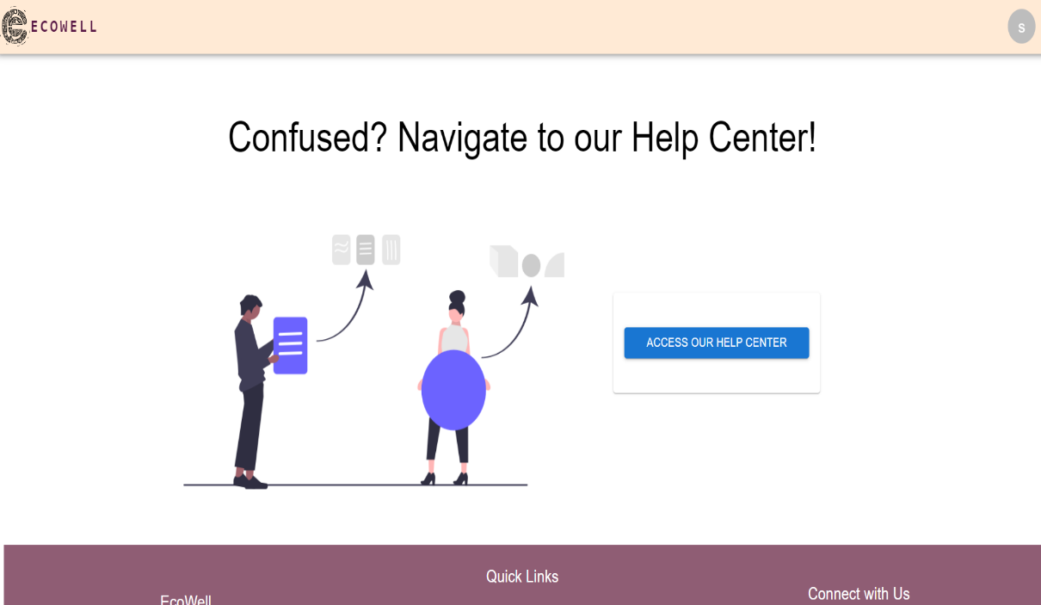
EXPORT, COMMUNITY FEEDBACK , HELP CENTER

Slide 13
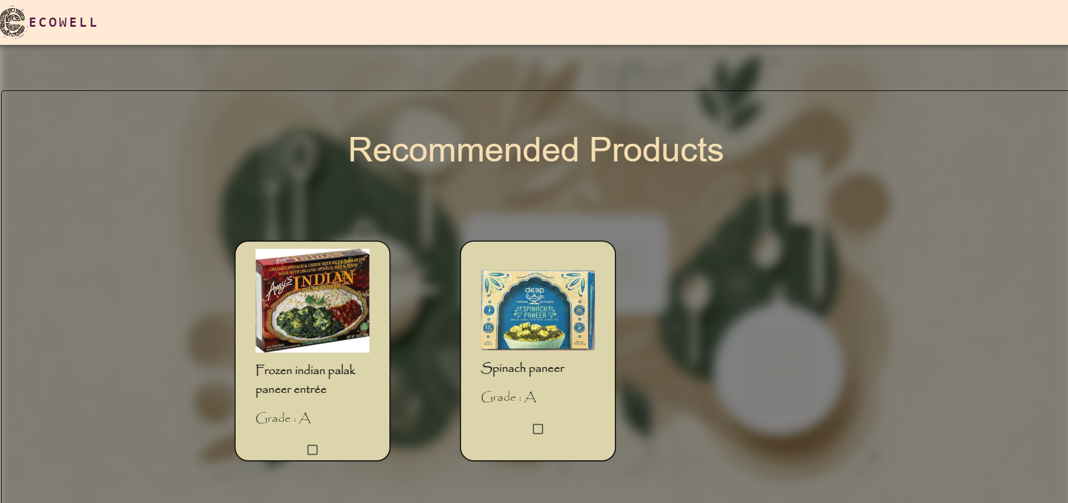
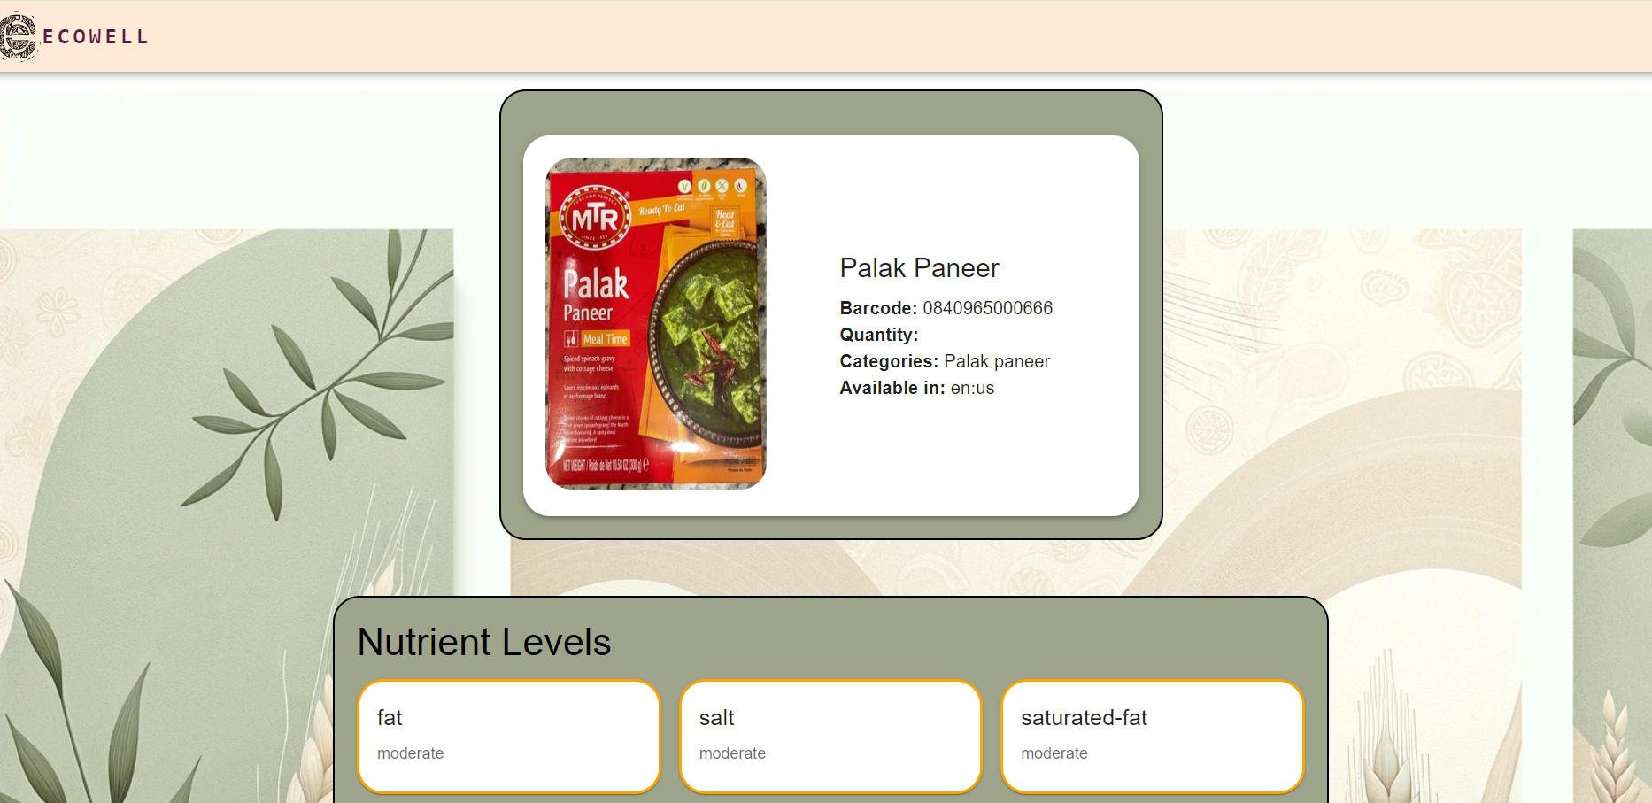
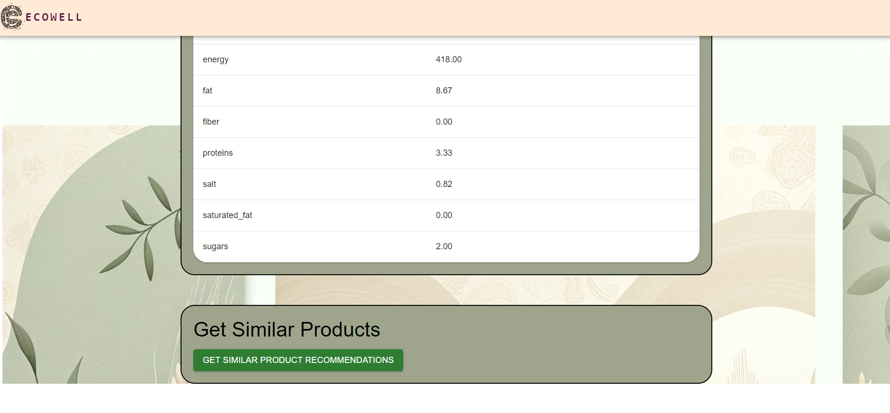
PRODUCT DETAILS AND RECOMMENDATION

Slide 14
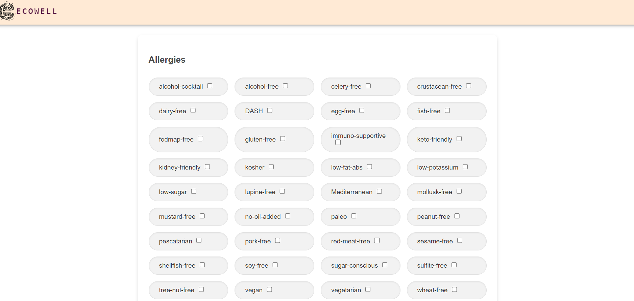
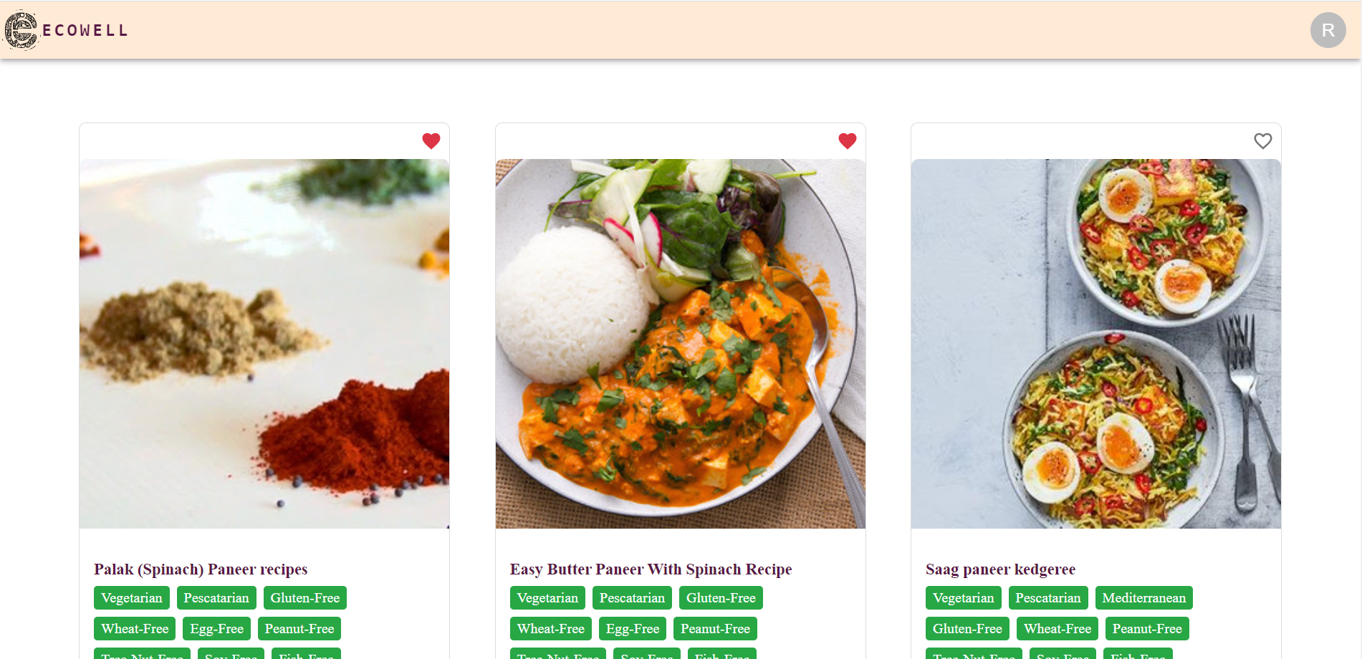
FAVORITE RECIPIES

Slide 15
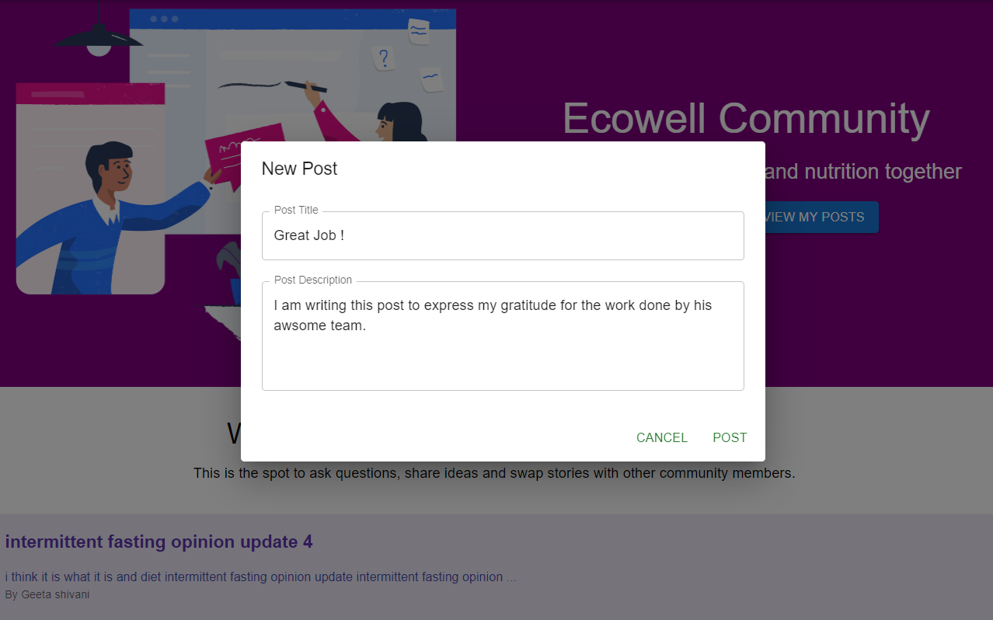
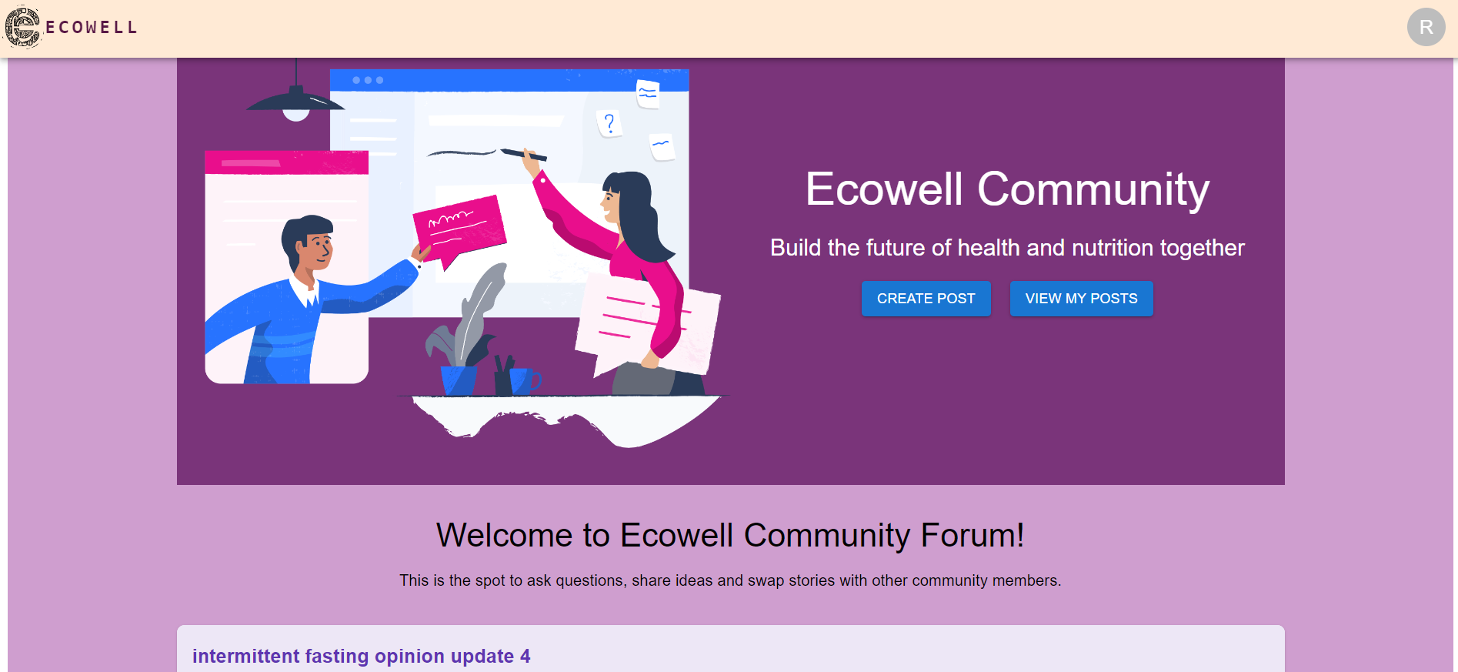
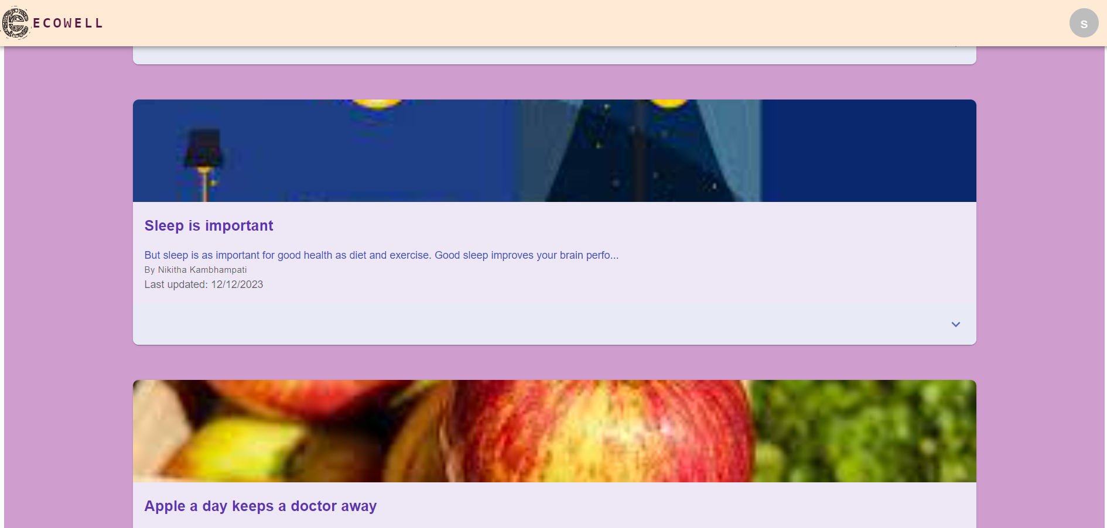
COMMUNITY PORTAL

Slide 16
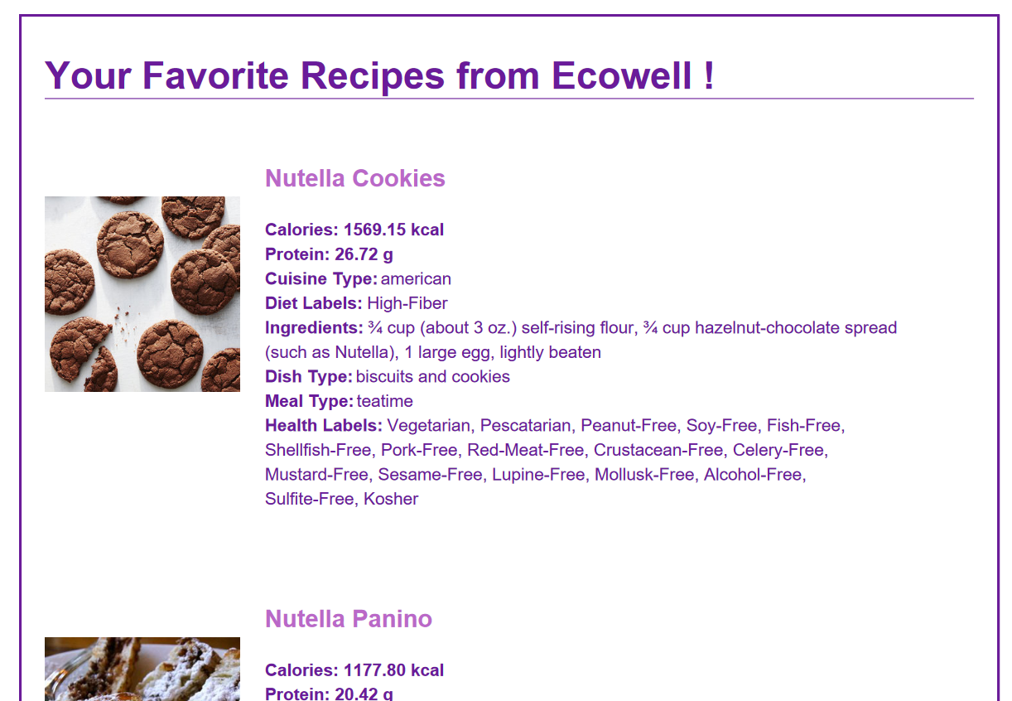
EXPORT PDF (FAVORITE RECIPES)

Slide 17
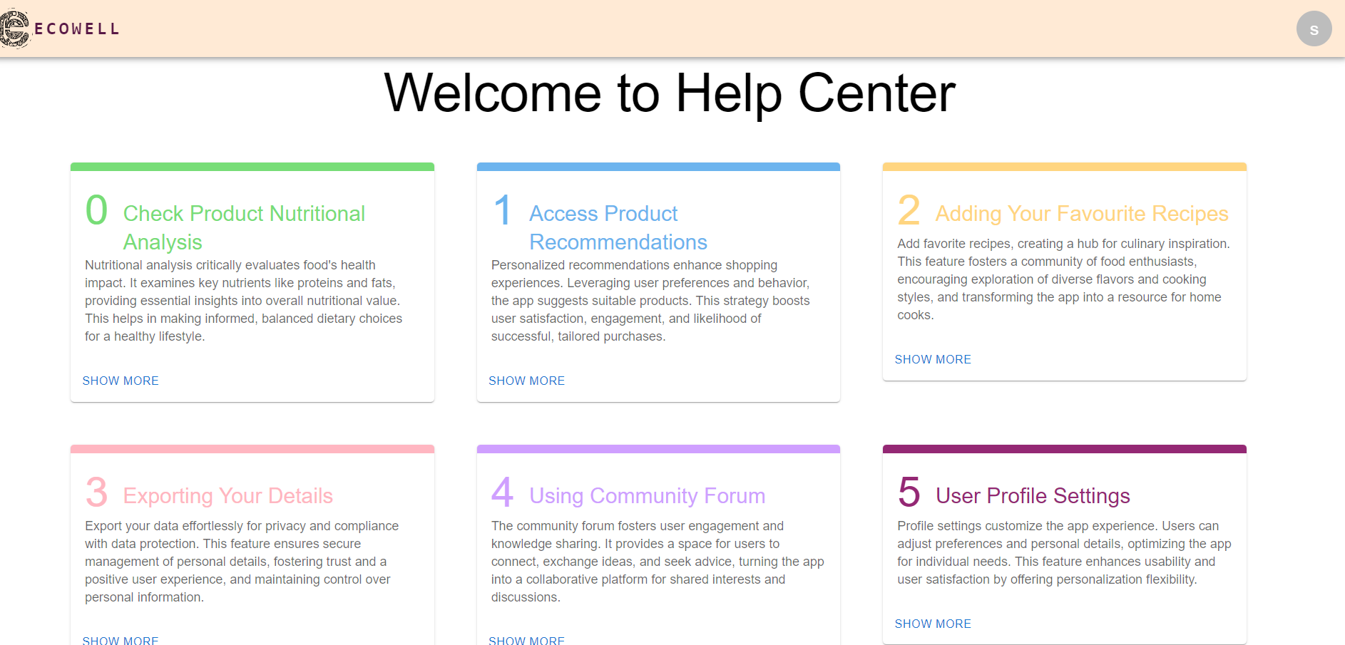
HELP CENTER – USER GUIDE TO APPLICATION

Slide 18
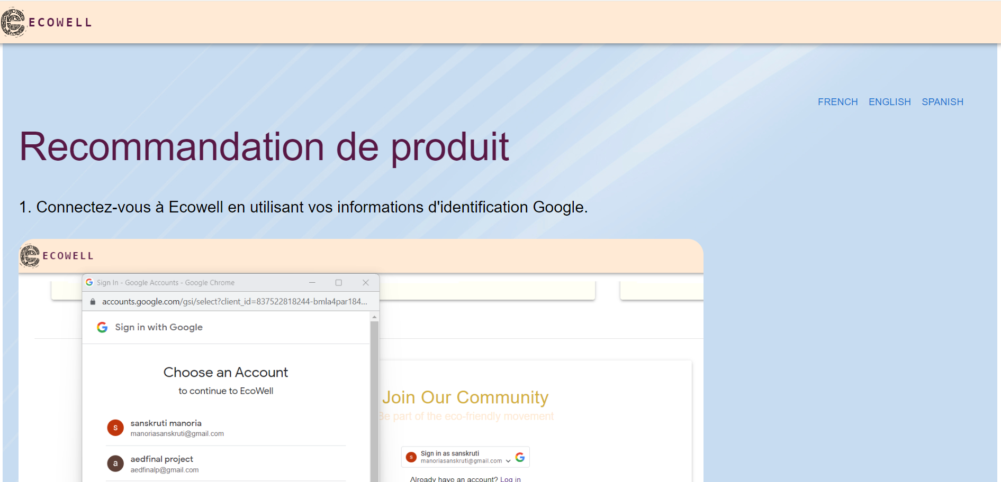
HELP CENTER - INTERNATIONALIZATION

Slide 19
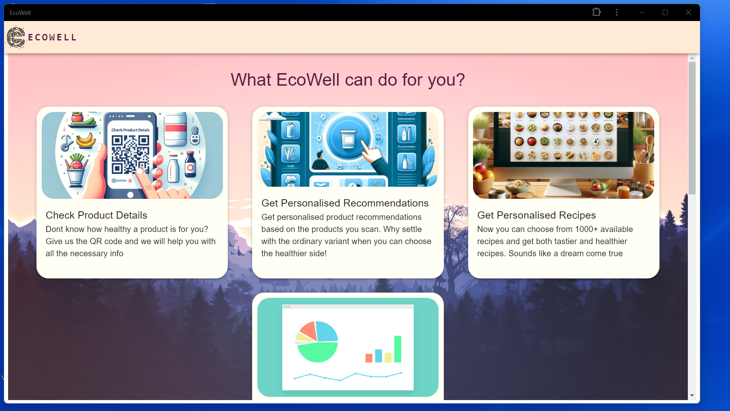
PWA

Slide 20
ECOWELL
THANK YOU FOR YOUR TIME!

